Slide 1
Engineered Stone: An Occupational Hygiene Perspective
Date: 02 May 2023
Presenter: Almi Bradfield-van Wyk

Slide 2
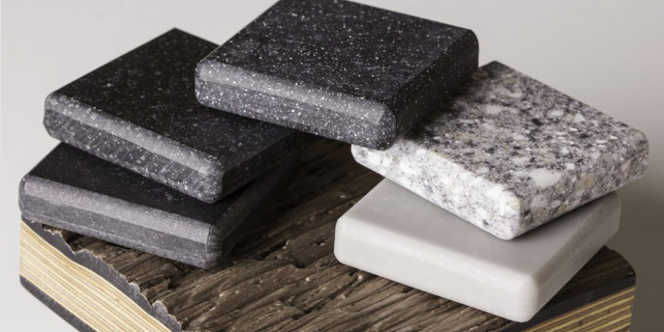
Engineered / Artificial / Manufactured Stone
Composite material
made from
crushed stone
bonded together by
resin and pigment
mixtures
Breathe freely New Zealand
AIOH Webinar Engineered Stone and the Complexity of its Health Effects
Notes:
Different types of engineered stone & definitions, neither NZ / Aus is part of the ISO Techincal Committee 328 on Engineered Stone established in 2020
Care should be taken to define engineered stone appropriately to assist in understanding the regulatory / enforcement requirements

Slide 3
Engineered Stone
Imported to New Zealand since early 2000
Growing home renovation market with preference for Engineered Stone
Small – Medium enterprises conducting fabrication and installation
Fabrication occur from slabs of bulk engineered stone
Cutting, Grinding, Sanding and polishing
Small particles of dust from engineered stone fabrication
Crystalline silica > 90 % from crushed stone
Volatile Organic Compounds from resin mixtures
Heavy metals from pigment mixtures
Notes:
Most SME don’t conduct occupational health surveillance / exposure monitoring – 2-5 employees
Crystalline Silica content not always accurately reflected in SDSs / SDSs not available

Slide 4
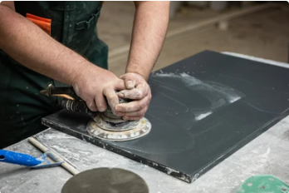
Why the hype?
NZ College of Physicians estimate 1000 persons exposed to engineered stone since 2000
WorkSafe identified 586 potentially exposed workers during their inspections between 2019 – 2022
Poor participation Voluntary RCS Accreditation Programme
Only 21 % of known exposed workers had lodged ACC claims
Ages of claimants range from under 20 years to mid-70s
workplaces fabricating & installing Engineered Stone
Health monitoring / surveillance not conducted for most
Breathlessness / coughing at rest, once symptoms are
present in young tradies, the disease has already advanced
Notes:
WorkSafe identified 586 potentially exposed workers during their inspections between 2019 – 2022 & expects the number to increase as former workers are identified / new workers enter the industry
WorkSafe conducted intensive inspections of 131 known businesses conducting work on engineered stone between 2019 to 2022
Notices were issued together with information in order to assist businesses in controlling the risk to worker’s health
Repeat visits revealed workplaces lapsing in control of the risk
Voluntary RCS Accreditation Programme run by the New Zealand Stone Advisory Group and IMPAC Services observed poor participation from the industry, as only 44 of the 131 businesses registered to participate and only 21 of those completed their audits, with only 2 reaching gold status.
NZESAG / IMPAC concluded that the program will be unsuccessful in future if it is not made compulsory for the trade.
It is important to note that Health Surveillance Monitoring is different from the ACC Assessment Pathway.
Health Monitoring is conducted routinely as a safeguard together with occupational exposure monitoring to ensure workers health are protected
Whereas, the ACC Assessment Pathway is a process to assess the health of persons who have potentially been exposed to high concentrations of crystalline silica during work on engineered stone

Slide 5
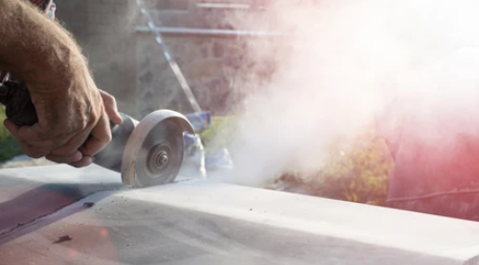
Situation in New Zealand
ACC launched the Accelerated Silicosis Assessment Pathway in September 2020.
140 claims had been lodged for assessment of accelerated silicosis by end of February 2023,
with 114 of these lodged since the introduction of the pathway.
https://www.level.org.nz/health-and-safety/airborne-and-other-pollutants/silica-dust/
Notes:
Indicates health monitoring not being conducted, GP / health professionals not trained on the ACC accelerated silicosis assessment pathway / exposure occurred outside of New Zealand during migrant work elsewhere / migrant workers in NZ not able to access the pathway
Might be due to individuals not having symptoms as of yet – young workforce = lung function seems normal but nodules may be present without decreased lung function & no scar tissue has formed yet = not easily detected through chronic silicosis health screening of x-ray and pulmonary function testing – requires CT scans for diagnosis in healthy workforce
More information: https://www.tewhatuora.govt.nz/assets/For-the-health-sector/Health-sector-guidance/Diseases-and-conditions/Accelerated-Silicosis-Assessement-Pathway-Guidance.pdf

Slide 6
NZ Panels Group
will no longer supply fabricators who aren’t registered with the Voluntary RCS Accreditation Programme
Silver / Gold status will be required by end of 2023 to continue being supplied with engineered stone
Shifting to ES <40% Crystalline Silica & will regularly have material tested to ensure supplied material complies to specifications
https://www.stuff.co.nz/business/131820506/major-engineered-stone-supplier-to-cut-off-fabricators-who-dont-protect-workers-from-toxic-dust-that-causes-incurable-silicosis

Slide 7
Situation in Australia
First case of Silicosis due to Engineered Stone fabrication 2015
7 cases of silicosis due to engineered stone fabrication 2018
Government funded industry screening introduced 2018/2019
Dry processing predominantly prior to 2019
2020, established guide for doctors
National Guidance provided – 21 February 2022
25% of stone benchtop industry diagnosed with silicosis
Government funded screening aided in diagnosis within the industry
3-4000 workforce, 1508 screened people by March 2023
Ban proposed if industry is not compliant by 2024
Notes:
Silicosis = regulatory systems failure
A-symptomatic individuals (young workforce = doesn’t have lung function difficulties until too late)
If regulation compliance / licensing fails – product will be banned in 2024 in Australia with talks that New Zealand might follow suite

Slide 8
Crystalline Silica
Well known hazard with health effects that are known & well established prevention
Why so many Silicosis cases from Engineered Stone?
- Massively Increasing industry demands
- Young workforce being exposed to high load of respirable crystalline silica & other compounds
- Scar tissue hasn’t yet developed as is characteristic of chronic silicosis
- leads to difficulty diagnosing from X-Rays & lung function testing, markers visible through CT
Double amount of crystalline silica in fabricated stone than in natural granite stone. (>90% compared with <45% in granite – OSHA/CDC
Only treatment for severe silicosis is a lung transplant – 50% lead to mortality within 3-year survival after transplant
Countertop workers have acute exposures leading to accelerated silicosis – Doesn’t take 10+ years to present but developed within 1-2years of exposure due to the high concentrations of respirable crystalline silica emitted during dry cutting and sweeping
Notes:
Engineered stone contains up to 90% crystalline silica, but SDS’s does not always reflect silica % accurately & some manufacturers don’t provide SDS’
Already crushed stone, mixed with resin. Furthermore, the microscopic analysis of engineered stone indicates that silica particles are not bonded with resin, which results in the release of silica dust from already crushed stone during grinding, cutting, sanding and polishing.
Smaller particles = Larger surface area, higher surface charge in comparison to natural stone – faster absorption / metabolising of particles once in body

Slide 9
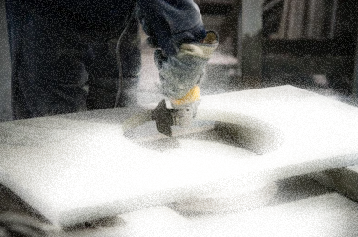
Workers potentially exposed
Primary Workplace
Fabricator / workshop
Multiple controls in place
Secondary Workplace
Installation point, onsite/commercial
Little / no controls in place
SEGs exposed:
CNC Router / Water Jet Operator
Saw Operators
Labourers
Shapers
Finishing Workers
Polishers
Supervisors
Office Workers
Notes:
Dry-processing and higher duration of exposure = high prevalence of silicosis
Air guns / compressed air used to remove clugs of dust from respirators
Installers and factory machinists –have highest exposure due to cutting, sanding etc
Not to exclude administration workers adjacent to fabrication workshops – some have been diagnosed in Australia already
Secondary exposures even with wet methods needs to be mitigated and controlled, as respirable crystalline silica particles within water droplets can be released once droplets evaporates
Onsite laundry facilities required to control secondary exposure and larger environment

Slide 10
What is silicosis?

Slide 11
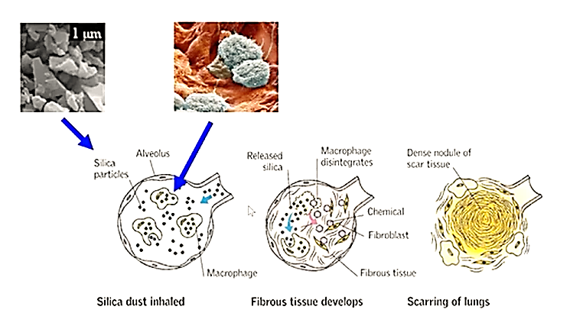
Mechanism of Silicosis
AIOH Webinar Engineered Stone and the Complexity of its Health Effects
Notes:
The mechanism of silicosis start with the inhalation of respirable crystalline silica particles, (dust fractions above the respirable size is excreted in the upper respiratory tract), these small particles enter the lungs and ends in the alveoli (lung sacs), where gas exchange processes happen in the lungs. The body’s immune system activates & tries to fight the abnormal body (in this case the crystalline silica particles), during which the macrophage ingests the silica particles but cannot destroy / metabolise them. The macrophage cell starts to disintegrate & gets absorbed into the cell wall of the alveoli where the unmetabolized particles of crystalline silica results in cell death of the alveoli. Over time (as seen with chronic silicosis), scar tissue develops throughout the upper lung due to unmetabolized crystalline silica particles. However, with accelerated silicosis, there hasn’t been sufficient time for scar tissue to develop, which is why diagnosis with X-Rays is difficult & in young healthy bodies, the lung function still seems normal even though the body is burdened by high amounts of crystalline silica particles.
Smaller particles = Larger surface area, higher surface charge in comparison to natural stone – faster absorption / metabolising of particles once in body
University of Adeleide conducted composition studies of nano dust particles in lungs & identified heavy metals (titanium, cobalt and copper), volatile organic compounds (predominantly styrene and phthalic anhydride, both are sensitizers and linked to occupational asthma) in the nano-dust fragment together with a variable percentage of crystalline silica (up to 95%).
Synergistic effects of these compounds in addition to the respirable crystalline silica fraction is unclear and further studies are recommended to better understand if catalytic / synergistic processes are responsible for the high amounts of accelerated silicosis cases identified.
Impaired lung function only visible on X-ray in severely advanced cases = too late
- Furthermore, extremely high quantities on crystalline silica / micro-dust inhalation = overload of body’s immune response & alveolar cell death
= Accelerated silicosis / COPD / autoimmune disease / kidney disease due to crystalline silica dust particles being carried into the body’s excretion system

Slide 12
Controlling Exposure

Slide 13
Control
Elimination
Replacing crystalline silica compound during engineered stone manufacture
Substitution
Low silica content engineered stone, natural stone products
Engineering Controls
Extraction ventilation, wet-cutting methods, maintain sharpness of blades, lower speed of machinery in order to control aerosol production
Isolation, Computer OP, Robots, room separation, boxing, enclosed system processes, computer operated cutting, sanding and polishing with lifting and cleaning equipment, reduce operator performing cuts
Suppression – On-tool Suppression: Slipstream Effect – atomized mist technology – small water mist particles = dust particle can not escape the mist (electrostatic force allows the mist particle to bind with the dust particle), Surfactants – chemical foams or tactical agent additive to the misting system – lower the surface tension of the mist, spray area increased (greater surface area = greater penetration into and around dust cloud / plume), Spray nozzles – fogging style (10-150 micrometre mist particle diameter)
Notes:
WHWB
Importance of control hierarchy – Elimination, Substitution (brings new risks / unknowns), Isolation, Engineering Controls, Administration, PPE
Crystalline silica is a natural substance found in the earth’s surface, difficult to eliminate
Substitution of crystalline silica compound with something else may result in new health hazards
It’s important to note that there’s a difference between general ventilation and extraction / local extraction ventilation, dilution ventilation may give rise to higher exposure if air movement result in contaminants moving through the breathing zone of workers

Slide 14
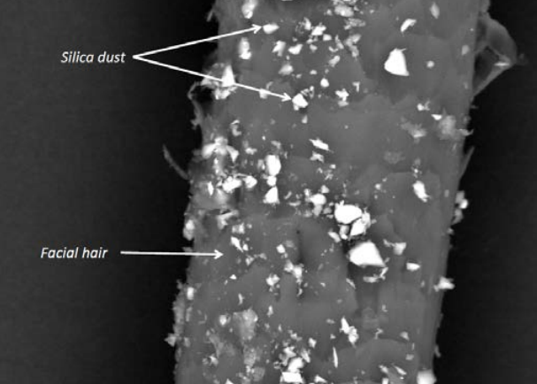
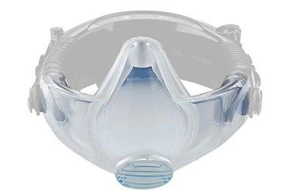
Control
Administration
Housekeeping, Cleaning, M/H Class Vacuums, Decontamination Units and dust removal booths, workplace monitoring, health surveillance, communication, training, consultation and waste management
Personal Protective Equipment
Last form of defence
High quality P2 fitted PAPR respiratory
protection that is fit tested
Notes:
Important to control water run-off and misting emission control to ensure secondary exposure control is efficient – prevention of unintended exposures to public
Unfortunately seen in industry as most often deployed as first line of defence
A hood or head top type, full face or half face powered air purifying respirator (PAPR) with at least a P2 filter must be worn as a minimum by workers carrying out: • fabricating, processing, cleaning or maintenance work in a fabrication workshop (including labourers and supervisors) • processing tasks during on-site installation.
Comparison of facial hair with respirable crystalline silica particle size indicated the importance of being clean shaven if half-face respirators are worn to prevent leakage of the respirator, which would mean the control has failed to protect the worker.
More information: https://www.worksafe.qld.gov.au/__data/assets/pdf_file/0013/32413/managing-respirable-crystalline-silica-dust-exposure-in-the-stone-benchtop-industry-code-of-practice-2019.pdf

Slide 15
Conclusion

Slide 16
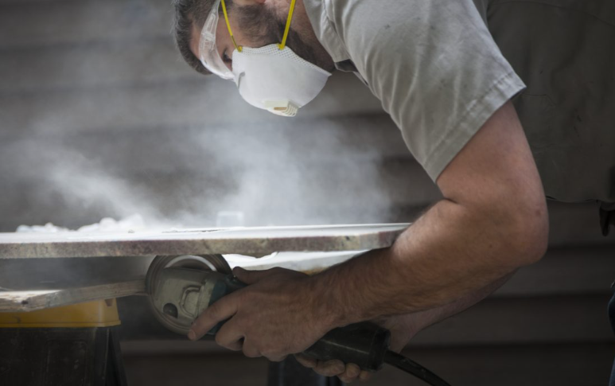
Engineered / Artificial / Manufactured Stone
Relatively new Industry
Young Workforce
Exposures <3 years
High exposures
Poor control measures
Often not included in Medical surveillance
Difficult to diagnose
Acute Silicosis
No cure
Notes:
- Industry relatively new – boom in early 2000s
Work force is young
Exposure levels are extremely high due to silica concentrations
Industry is not regulated & pricing competition force short-cuts
Often employed immigrants (some kiwi’s were exposed in Australia) – cannot claim through ACC, will need to register for Australian compensation

Slide 17
Q & A

Slide 18
THANK YOU
WWW.CHEMSAFETY.CO.NZ
info@chemsafety.co.nz
0800 366 370

Slide 19
Surveys – identification of asbestos materials
Assessing – Inspecting during and after removal
Management of Asbestos risk
Location Compliance Certification
Certified Handler Certification
Site Compliance Audits
Recognition – Identification of health hazards
Evaluation – Measurement and assessment of exposure
Control – Recommendations on practical solutions
Chemsafety is a New Zealand privately owned business.
Our Consultants are all Science graduates.
Let the experts train your team.
Chemical Handling
Certified Handlers
Asbestos Awareness
CHEMICAL CONSULTANCY
ASBESTOS
HAZARDOUS SUBSTANCES
OCCUPATIONAL HYGIENE
TRAINING
0800 366 3700 – www.chemsafety.co.nz – info@chemsafety.co.nz

Slide 20
HSE Guidance
HSG201 “Controlling exposure to stone dust”
https://www.hse.gov.uk/pubns/priced/hsg201.pdf
COSHH sheet (ST series) for specific tasks
https://www.hse.gov.uk/pubns/guidance/stseries.htm
Control of exposure to silica dust
https://www.hse.gov.uk.pubns/indg463.pdf
Work Plan 2019-20: Occupational Lung Disease caused by… and Respirable Crystalline Silica, in manufacturing industries
https://www.hse.gov.uk/foi/internalops/og/og-00109.pdf

